Slide 1

Spanning Trees
Data Structure | Graph
Course: Data Structure | Chapter: Graph | Bachelor of Engineering
DISCOVER · LEARN · EMPOWER
Notes:
Welcome everyone to today's lecture on Spanning Trees within the Graph chapter. We will explore how to connect all vertices with minimum edges. This concept is fundamental for network design and optimization problems. Remember, our motto is Discover. Learn. Empower.

Slide 2
Course Outcomes
SLIDE 2 / 14
Course Outcome
CO | BT LEVEL | DESCRIPTION
CO1 | BT1 | Understand and apply basic data structures, algorithms, complexity analysis, ADTs, arrays and linked lists.
CO2 | BT2 | Apply and implement stacks and queues in problem-solving.
CO3 | BT3 | Analyse and apply searching, sorting, and hashing techniques.
CO4 | BT4 | Construct and apply tree structures and traversal techniques.
CO5 | BT5 | Represent and solve graph problems using DFS, BFS, and graph algorithms.
Chandigarh University
2 / 14
Notes:
Today's lecture directly addresses two specific course outcomes. CO4 focuses on constructing tree structures, which is exactly what a spanning tree is. CO5 requires us to apply graph algorithms like DFS and BFS to solve these problems. By the end, you will be able to construct these trees independently.

Slide 3
Learning Objectives
SLIDE 3 / 14
Learning Outcomes
1
Define a spanning tree and identify its essential properties.
2
Analyze the relationship between spanning trees and cycles in graphs.
3
Construct spanning trees using Depth First Search and Breadth First Search.
4
Calculate the number of possible spanning trees for a complete graph.
5
Evaluate the cost of spanning trees to find the Minimum Spanning Tree.
Chandigarh University
3 / 14
Notes:
By the end of this session, you will be able to define a spanning tree and distinguish it from a general graph. You will analyze how removing edges eliminates cycles while maintaining connectivity. We will also construct these trees using standard algorithms and calculate their costs.

Slide 4
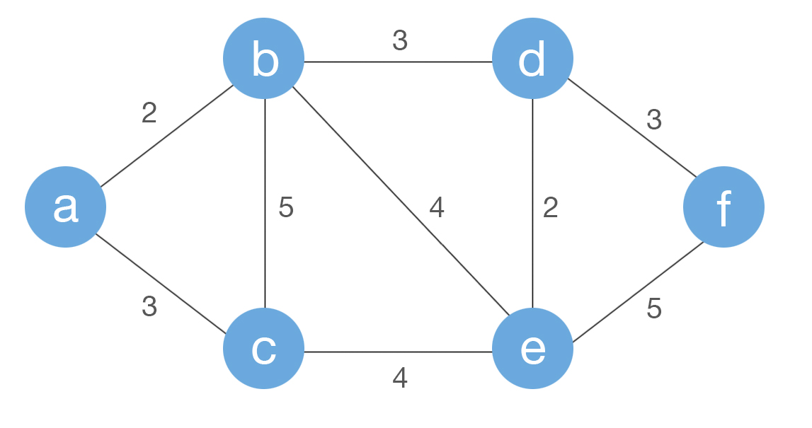
Lecture
SLIDE 4 / 14
Definition and Properties
1
A spanning tree is a subgraph that includes all vertices of the original graph.
2
It must be connected, meaning there is a path between every pair of vertices.
3
It must be acyclic, containing no loops or cycles of any length.
4
A spanning tree with V vertices always contains exactly V minus 1 edges.
5
If the original graph is disconnected, it has no spanning tree.
6
A spanning tree is a minimal connected subgraph of the original graph.
Coderbyte | The #1 Coding Assessment Platform
Chandigarh University
4 / 14
Notes:
Think of a spanning tree as the skeleton of the graph. It keeps all the cities (vertices) connected but removes all the redundant roads (edges) that create loops. If you have 5 cities, you need exactly 4 roads to connect them all without any loops. This property is crucial for network efficiency.

Slide 5
Lecture
SLIDE 5 / 14
Uniqueness and Existence
1
A spanning tree exists if and only if the graph is connected.
2
A connected graph with V vertices has at least one spanning tree.
3
The spanning tree of a graph is not necessarily unique.
4
Different spanning trees can be formed by removing different sets of edges.
5
A complete graph with V vertices has V raised to the power of V minus 2 spanning trees.
6
A tree itself is its own unique spanning tree.
Source: d14qv6cm1t62pm.cloudfront.net
Chandigarh University
5 / 14
Notes:
It is important to note that a spanning tree is rarely unique. You can often remove different edges to break cycles and still connect all vertices. For example, a square graph has 4 different spanning trees. However, if the graph is already a tree, it has only one spanning tree: itself.

Slide 6
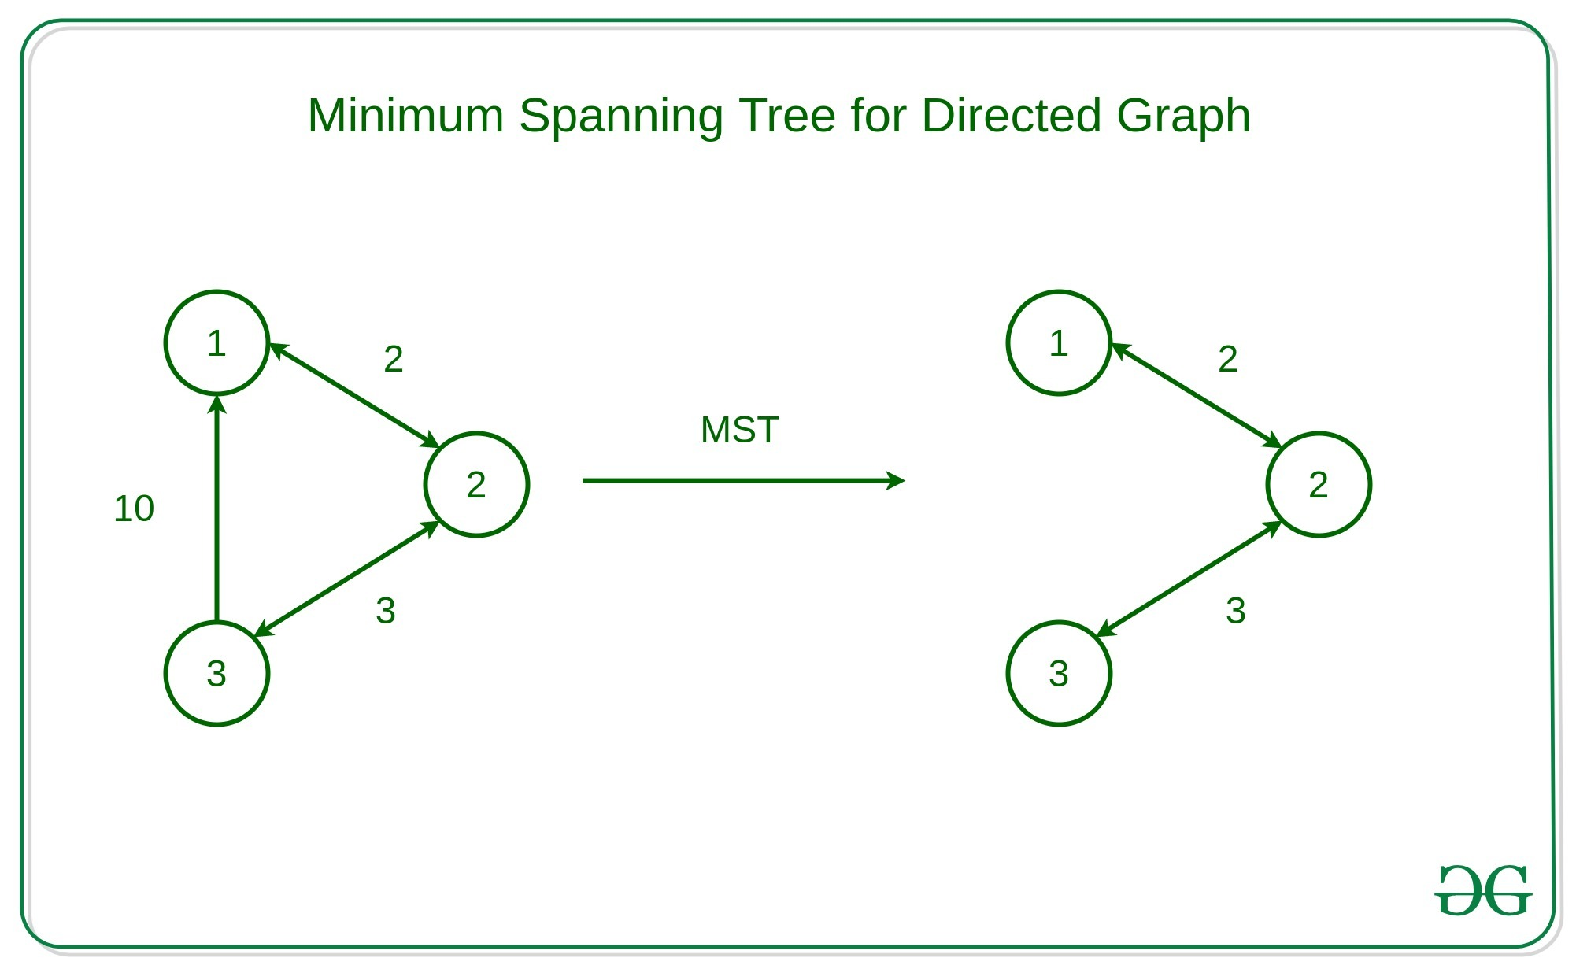
Lecture
SLIDE 6 / 14
Cycles and Fundamental Cycles
1
Adding any non-tree edge to a spanning tree creates exactly one cycle.
2
This cycle is called a fundamental cycle associated with that specific edge.
3
The number of fundamental cycles equals the number of edges minus V plus 1.
4
Fundamental cycles form a basis for the cycle space of the graph.
5
Removing any edge from a cycle restores the tree property.
6
This concept is vital for detecting cycles in network analysis.
Source: media.geeksforgeeks.org
Chandigarh University
6 / 14
Notes:
When you add an edge back to a spanning tree, you create a loop. This is called a fundamental cycle. The number of such cycles depends on how many extra edges you have. This relationship helps us understand the redundancy in a network. If you remove any edge from that loop, you return to a valid spanning tree.

Slide 7
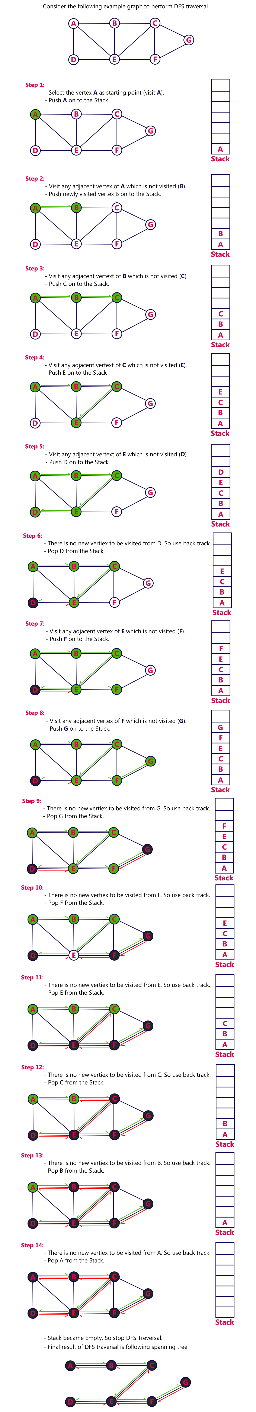
Lecture
SLIDE 7 / 14
Construction via DFS
1
Depth First Search constructs a spanning tree by exploring as far as possible.
2
The algorithm visits a vertex and recursively visits its unvisited neighbors.
3
Edges used to discover new vertices form the DFS spanning tree.
4
Back edges in DFS connect a vertex to an ancestor in the tree.
5
The resulting tree depth depends on the order of vertex traversal.
6
DFS trees are useful for detecting cycles and articulation points.
Source: www.btechsmartclass.com
Chandigarh University
7 / 14
Notes:
DFS builds the tree by going deep into the graph before backtracking. Imagine exploring a maze; you follow one path until you hit a dead end, then you backtrack. The edges you used to reach new rooms form the tree. The order in which you visit neighbors changes the shape of the resulting tree.

Slide 8
Lecture
SLIDE 8 / 14
Construction via BFS
1
Breadth First Search constructs a spanning tree by exploring neighbors level by level.
2
The algorithm visits all neighbors of a vertex before moving to the next level.
3
Edges used to discover new vertices form the BFS spanning tree.
4
BFS trees minimize the maximum distance from the root to any vertex.
5
The resulting tree is often shallower than a DFS tree.
6
BFS trees are optimal for finding shortest paths in unweighted graphs.
Chandigarh University
8 / 14
Notes:
BFS builds the tree by exploring all neighbors at the current depth before moving deeper. Think of a ripple in a pond expanding outward. This method ensures that the tree is as shallow as possible. It is particularly useful when you need the shortest path in an unweighted network.

Slide 9
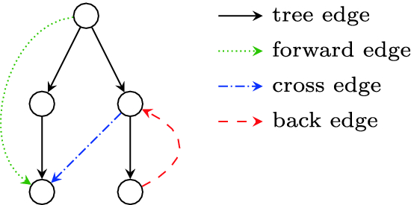
Worked Example
SLIDE 9 / 14
DFS
GOVERNING EQUATION
Total edges in tree: 3, which equals V minus 1 for V=4
1
Consider a graph with vertices A, B, C, D and edges (A,B), (A,C), (B,D), (C,D).
2
Starting at A, DFS visits B, then D, then backtracks to A.
3
From A, DFS visits C, which connects to D (already visited).
4
The DFS tree edges are (A,B), (B,D), and (A,C).
5
The edge (C,D) is a back edge creating a cycle A-B-D-C-A.
Source: cdn.prod.website-files.com
Chandigarh University
9 / 14
Notes:
Let's trace this manually. We start at A, go to B, then to D. D connects to C, but C is unvisited, so we go there. Wait, in my example, C connects to D. Let's say we visit C from A. Then C connects to D. D is visited. So (C,D) is a back edge. The tree has edges (A,B), (B,D), (A,C). This forms a valid tree with 3 edges.

Slide 10
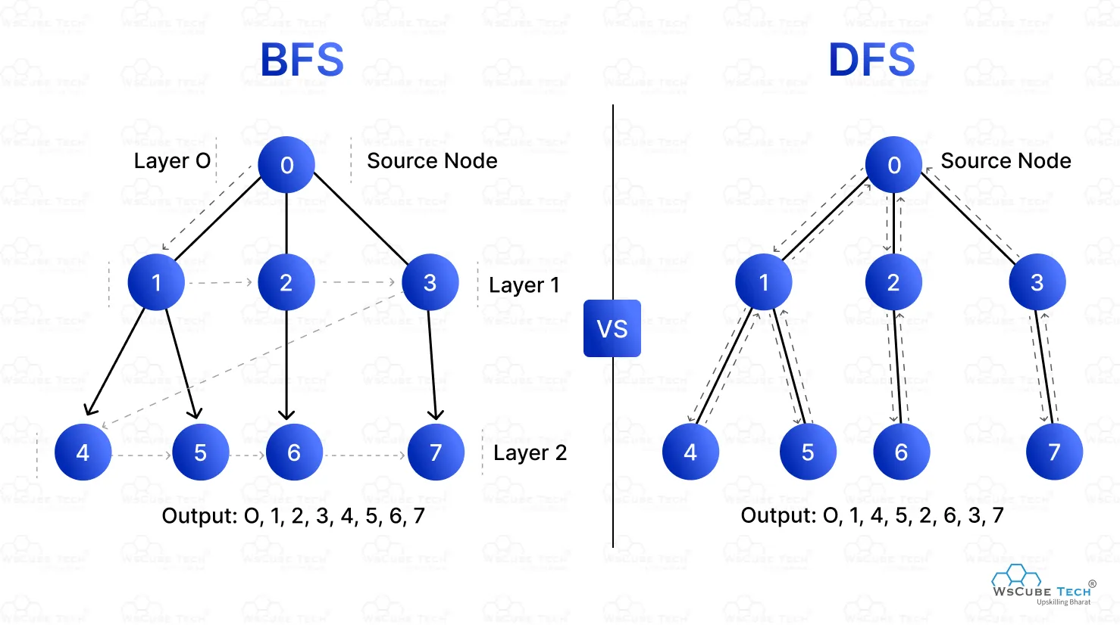
Worked Example
SLIDE 10 / 14
BFS
1
Using the same graph, start BFS at vertex A.
2
Level 0 contains A. Level 1 contains neighbors B and C.
3
Edges (A,B) and (A,C) are added to the BFS tree.
4
Level 2 contains D, discovered from B (or C).
5
Edge (B,D) is added to the tree.
6
Edge (C,D) is a cross edge connecting two vertices at the same level.
Source: deen3evddmddt.cloudfront.net
Chandigarh University
10 / 14
Notes:
Now let's do BFS on the same graph. We start at A. We see B and C, so we add edges (A,B) and (A,C). Then we look at B's neighbors. We see D, so we add (B,D). C also connects to D, but D is already visited. This creates a cross edge. The resulting tree is shallower than the DFS tree.

Slide 11
Lecture
SLIDE 11 / 14
Minimum Spanning Trees
1
A Minimum Spanning Tree (MST) has the minimum total edge weight.
2
MSTs are used to minimize cost in network design and routing.
3
Kruskal's algorithm builds an MST by adding edges in increasing order.
4
Prim's algorithm builds an MST by growing a tree from a starting vertex.
5
Both algorithms guarantee an optimal solution for connected weighted graphs.
6
The MST is unique if all edge weights are distinct.
Chandigarh University
11 / 14
Notes:
When edges have weights, we often want the cheapest way to connect everything. This is the Minimum Spanning Tree. Kruskal's algorithm sorts all edges and adds them if they don't form a cycle. Prim's algorithm starts at a node and greedily adds the cheapest connection. Both methods ensure we get the lowest possible total cost.

Slide 12
Lecture
SLIDE 12 / 14
Common Pitfalls
1
Confusing a spanning tree with a shortest path tree.
2
Assuming a spanning tree is unique for every graph.
3
Forgetting that a disconnected graph has no spanning tree.
4
Counting edges incorrectly; a tree with V vertices must have V-1 edges.
5
Mistaking back edges or cross edges for tree edges in traversal.
6
Applying MST algorithms to unweighted graphs without assigning weights.
Chandigarh University
12 / 14
Notes:
Students often confuse spanning trees with shortest path trees. Remember, a spanning tree just connects everything, it doesn't minimize distance. Also, don't assume uniqueness; most graphs have multiple spanning trees. Always check if the graph is connected first. Finally, ensure you count exactly V-1 edges for a tree with V vertices.

Slide 13
Lecture
SLIDE 13 / 14
Key Takeaways
1
A spanning tree connects all vertices with exactly V-1 edges and no cycles.
2
DFS and BFS are standard algorithms to construct spanning trees.
3
Adding an edge to a spanning tree creates exactly one fundamental cycle.
4
Minimum Spanning Trees minimize the total weight of the connecting edges.
5
Spanning trees are essential for network design, routing, and cycle detection.
Chandigarh University
13 / 14
Notes:
To summarize, a spanning tree is a minimal connected subgraph with V-1 edges. We can build them using DFS or BFS. They are crucial for finding cycles and designing efficient networks. Remember, the MST gives us the cheapest connection for weighted graphs. These concepts are foundational for advanced graph algorithms.

Slide 14
Lecture
SLIDE 14 / 14
References
DATA STRUCTURES
A Pseudocode Approach with C — Gilberg, Forouzan
• Data Structures — Lipschutz
• Data Structure Using C — AK Sharma
• C and Data structure — P. S. Deshpandey
Chandigarh University
14 / 14
Notes:
For further reading, please refer to the textbooks listed on this slide. Gilberg and Forouzan provide excellent pseudocode approaches. Lipschutz offers a comprehensive theoretical background. Sharma and Deshpandey are great for C implementation details. These resources will help you master the algorithms discussed today.

